Slide 1

FINANCIAL RATIO ANALYSIS OF MPHASIS COMPANY LTD
Presented by : Apeksha Dhongadi
Topic : Financial ratio analysis
Company : Mphasis company ltd

Slide 2
INDUSTRY PROFILE
Information technology (IT) is the application of computers to store, retrieve, transmit and manipulate data, often in the context of a business or other enterprise. IT is considered a subset of information and communications technology (ICT).
The it industry is a fast-growing and dynamic sector that drives innovation and economic development. With increasing digital transformation, it continues to create opportunities for businesses and employment worldwide.

Slide 3

COMPANY PROFILE
Mphasis ltd. Is an indian multinational information technology services and consulting company with its headquarters in bangalore. Its origins trace back to a merger in 2000 between mphasis corporation, an IT consulting company based in the U.S., And BFL software ltd., An indian IT firm.
Initially, mphasis concentrated on providing it services to clients across various sectors, including banking, financial services, telecommunications, and logistics. A significant turning point occurred in 2006 when electronic data systems (EDS) acquired mphasis, facilitating an expansion of its global footprint. Just two years later, in 2008, EDS itself was acquired by hewlett-packard (HP).

Slide 4
PRODUCTS AND SERVICES
PRODUCTS
SERVICEDS
Cloud solutions
Artificial intelligence and machine learning platforms
Data analytics tools
Cybersecurity solutions
Automation and devops platforms
Core banking and insurance platforms
Enterprise applications and custom software
Application development and maintenance
IT infrastructure management
Business process outsourcing (BPO)
Cloud migration and modernization
Data management and analytics services
Consulting and digital transformation
Customer experience management

Slide 5
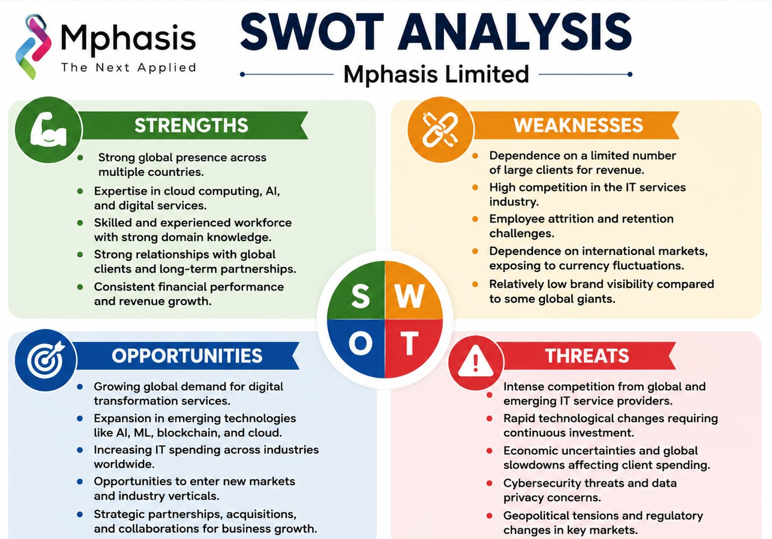

Slide 6
METHODOLOGY
The study is based on primary data & secondary data.
Data is collected from annual reports of mphasis company limited.
Financial statements such as balance sheet and profit & loss account are used for analysis.
Ratio analysis method is used to evaluate financial performance.

Slide 7
RATIO ANALYSIS
MEANING :
Ratio analysis is a technique used to evaluate the financial performance of a company by analyzing relationships between various financial figures in its financial statements (like the balance sheet, income statement, and cash flow statement).
TYPES OF RATIOS :
1.Liquidity Ratio
Current Ratio = Current Ratio / Current Laibilites
The current ratio shows an increasing trend over the five years, indicating that mphasis limited maintained a strong liquidity position and was capable of meeting its short-term obligations efficiently.

Slide 8
2. Profitability Ratio
Net Profit Ratio = Profit For The Year / Net Sales X 100
The net profit ratio of mphasis limited shows a decreasing trend over the years, indicating a reduction in the company’s profitability. This may be due to increased operating expenses, higher costs, or changes in revenue growth during the study period.
Eanings Per Share =Net Profit /No. Of Equity Shares
The earnings per share (EPS) of mphasis limited shows an increasing trend, indicating higher profitability and better returns to shareholders. It reflects the company’s strong financial performance during the study period.

Slide 9
3. Solvency / Leverage Ratio
Debt Equity Ratio = Total Debt / Shareholders Funds
The debt–equity ratio of mphasis limited shows a decreasing trend over the years, indicating lower dependence on external borrowings and a strong financial position.
Proprietary Ratio = Shareholders Funds / Total Assets
The proprietary ratio of mphasis limited shows a decreasing trend over the years, indicating lower contribution of shareholders’ funds towards total assets and increased dependence on external liabilities during the study period.

Slide 10
FINDINGS
Liquidity & Solvency
Strong liquidity: high current ratio ensures good short-term solvency.
Cash constraints: low cash ratio indicates limited immediate cash availability.
Low risk: declining debt-to-equity and debt-to-asset ratios show low debt dependence.
Strong ownership: a robust proprietary ratio proves assets are mainly owner-financed.
.Fluctuating capital: working capital remains positive but experiences volatility.
Efficiency & Profitability
Moderate efficiency: asset turnover shows average utilization efficiency.
Declining profitability: net profit, operating profit, and ros show downward trends
Inconsistent operations: PBT margin displays operational inconsistency.
Lower returns: decreasing ronw and equity returns reduce investor value
Stable ROI/ROA: return on investment and assets remain stable with slight variations.

Slide 11
SUGGESTIONS
The company should focus on profitability by optimizing operating and administrative expenses.
The accounts receivable collection efficiency must be improved to strengthen cash flow and liquidity.
The capital structure should remain balanced by strategically optimizing the mix of debt and equity.
The return on shareholders' funds can be increased through more aggressive profit generation.
The investment in high-growth digital areas like cloud and ai must expand to drive future revenue.
The market trends and competitor strategies require continuous monitoring to maintain a competitive edge.
The long-term sustainable growth of mphasis ltd. Relies on maximizing asset and resource utilization efficiency.

Slide 12
CONCLUSION
Based on the overall ratio analysis, mphasis ltd. Is financially stable, backed by strong liquidity and minimal debt dependency. However, a declining trend in profitability highlights an immediate need to enhance operational efficiency and enforce stricter cost controls on operating expenses.
To sustain smooth operations, the company must prioritize cash flow management by accelerating accounts receivable collections and optimizing working capital. Ultimately, focusing on profitability, resource efficiency, and strategic cost reduction will enable mphasis ltd. To achieve sustainable long-term growth and a stronger financial position.

